Slide 1

Kickwrangler
Predict Which Kickstarter Projects Won’t Deliver
Alex McCauley

Slide 2
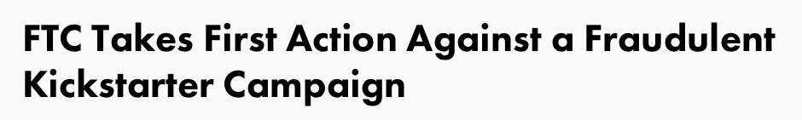
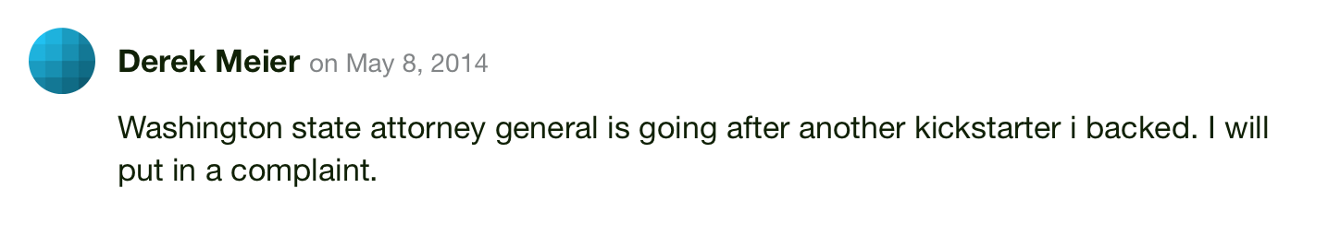
$1,768,328,118
pledged to Kickstarter projects over 6 years
It doesn’t always work out…
Kickwrangler predicts the projects most likely to not deliver.

Slide 3

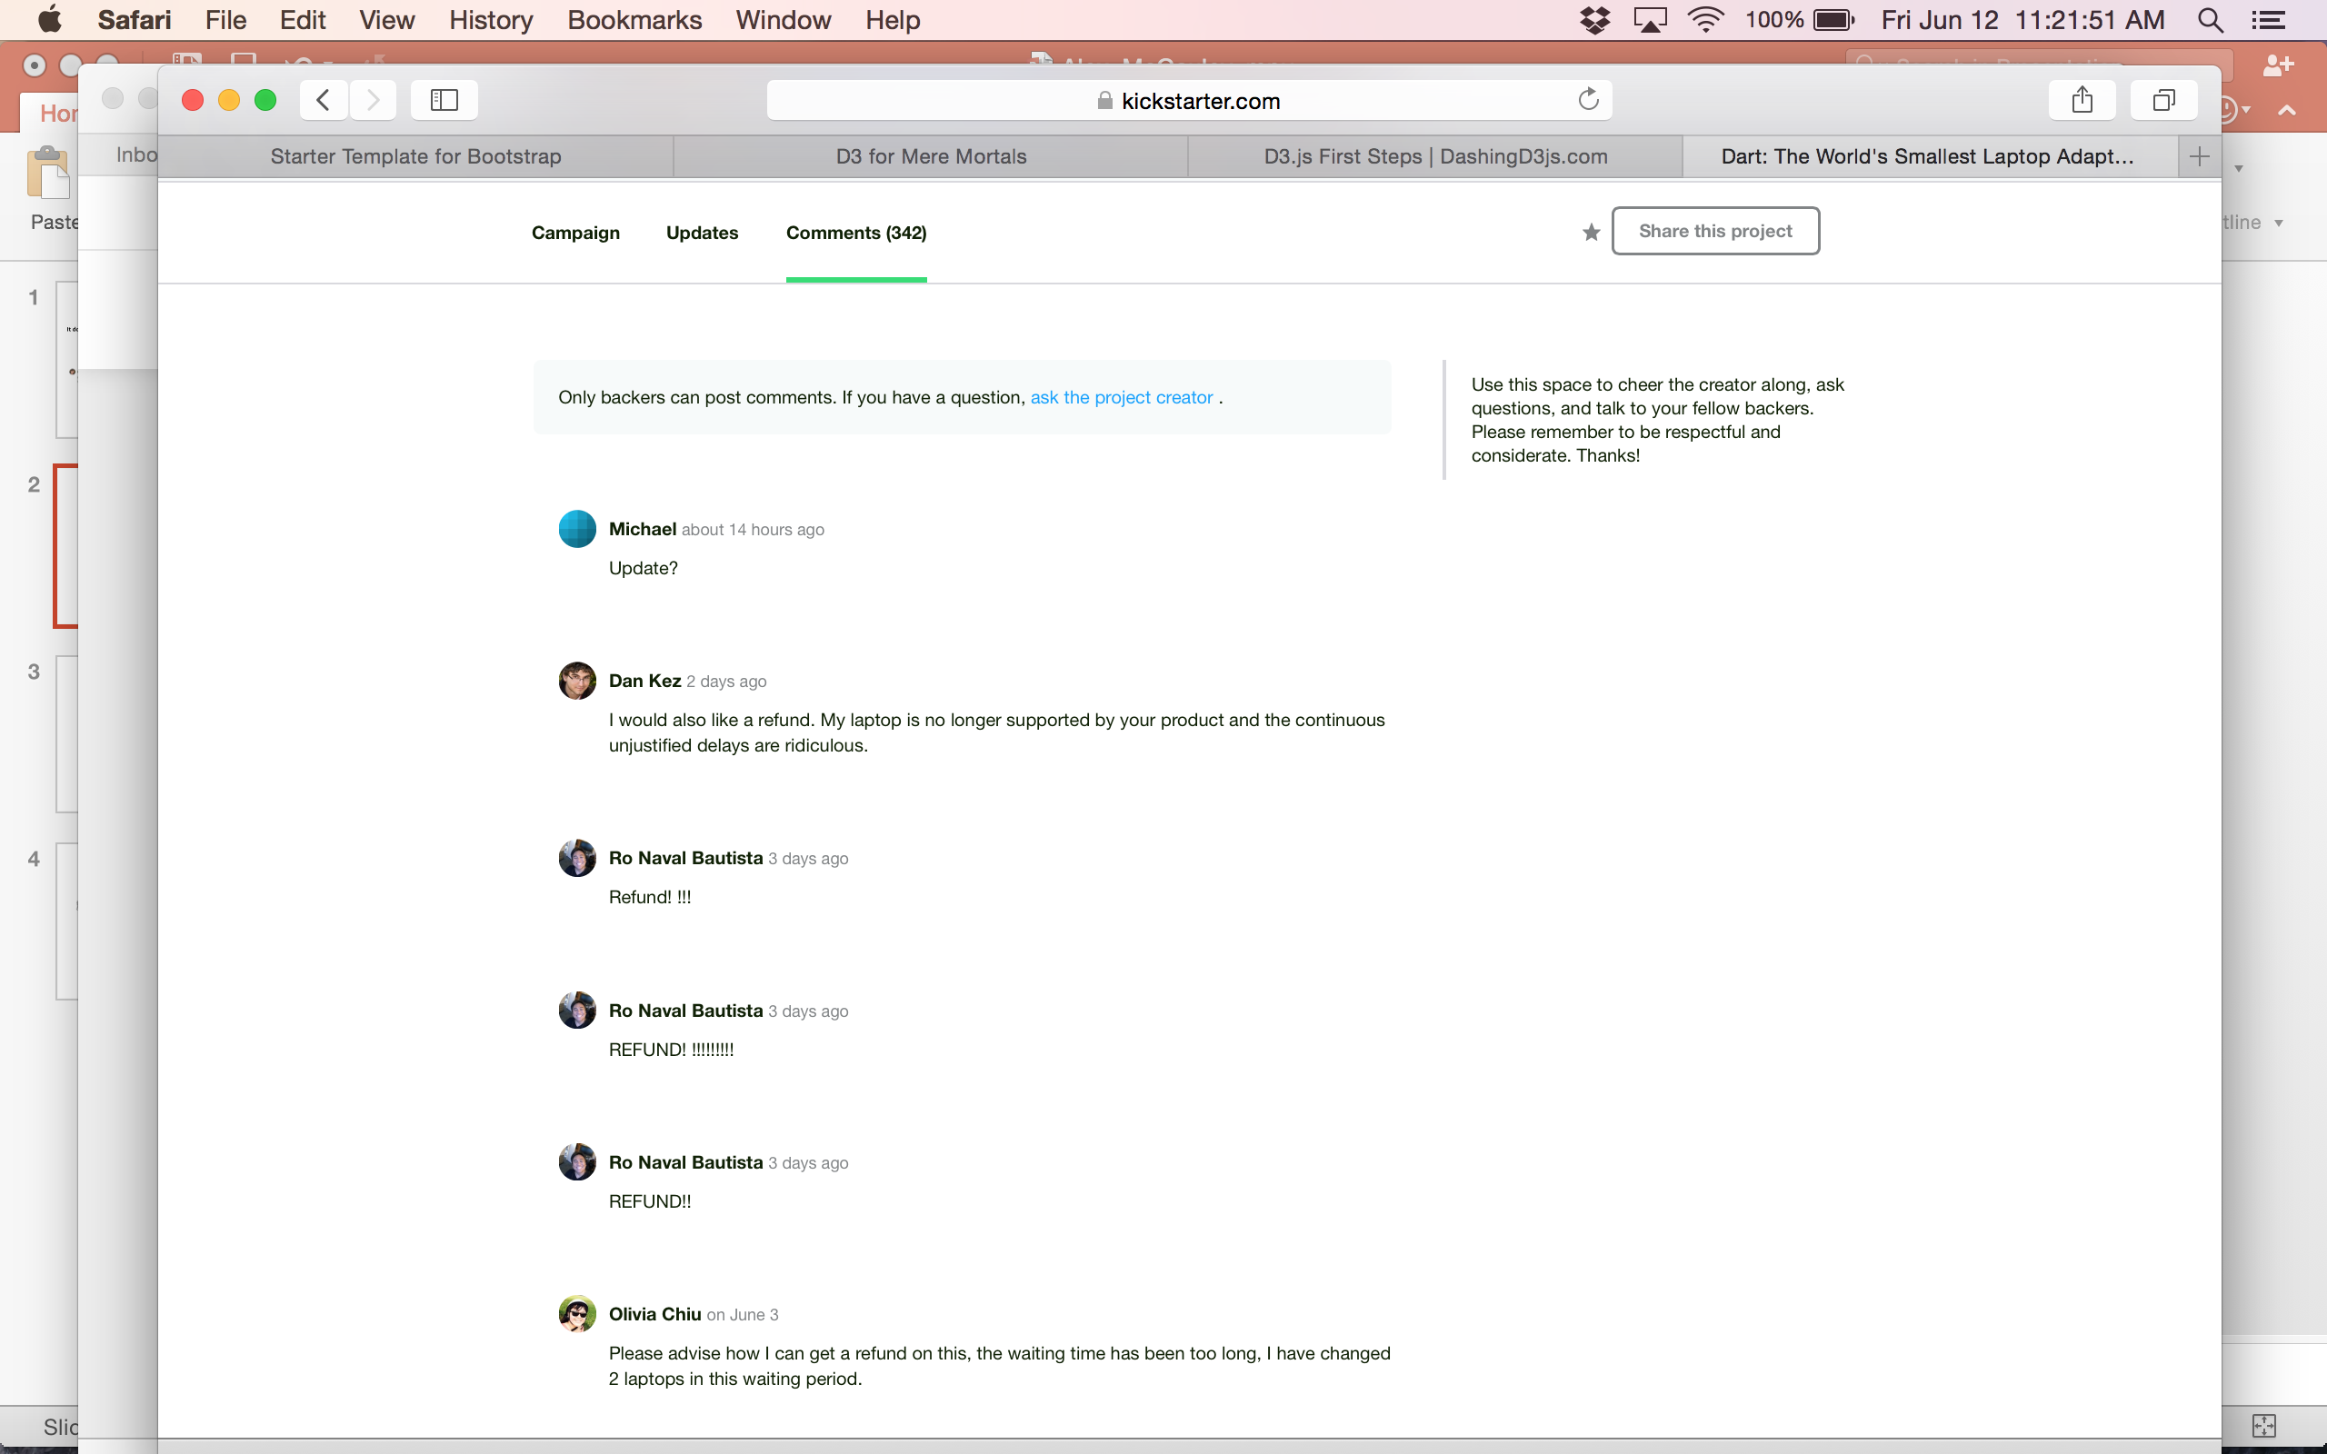
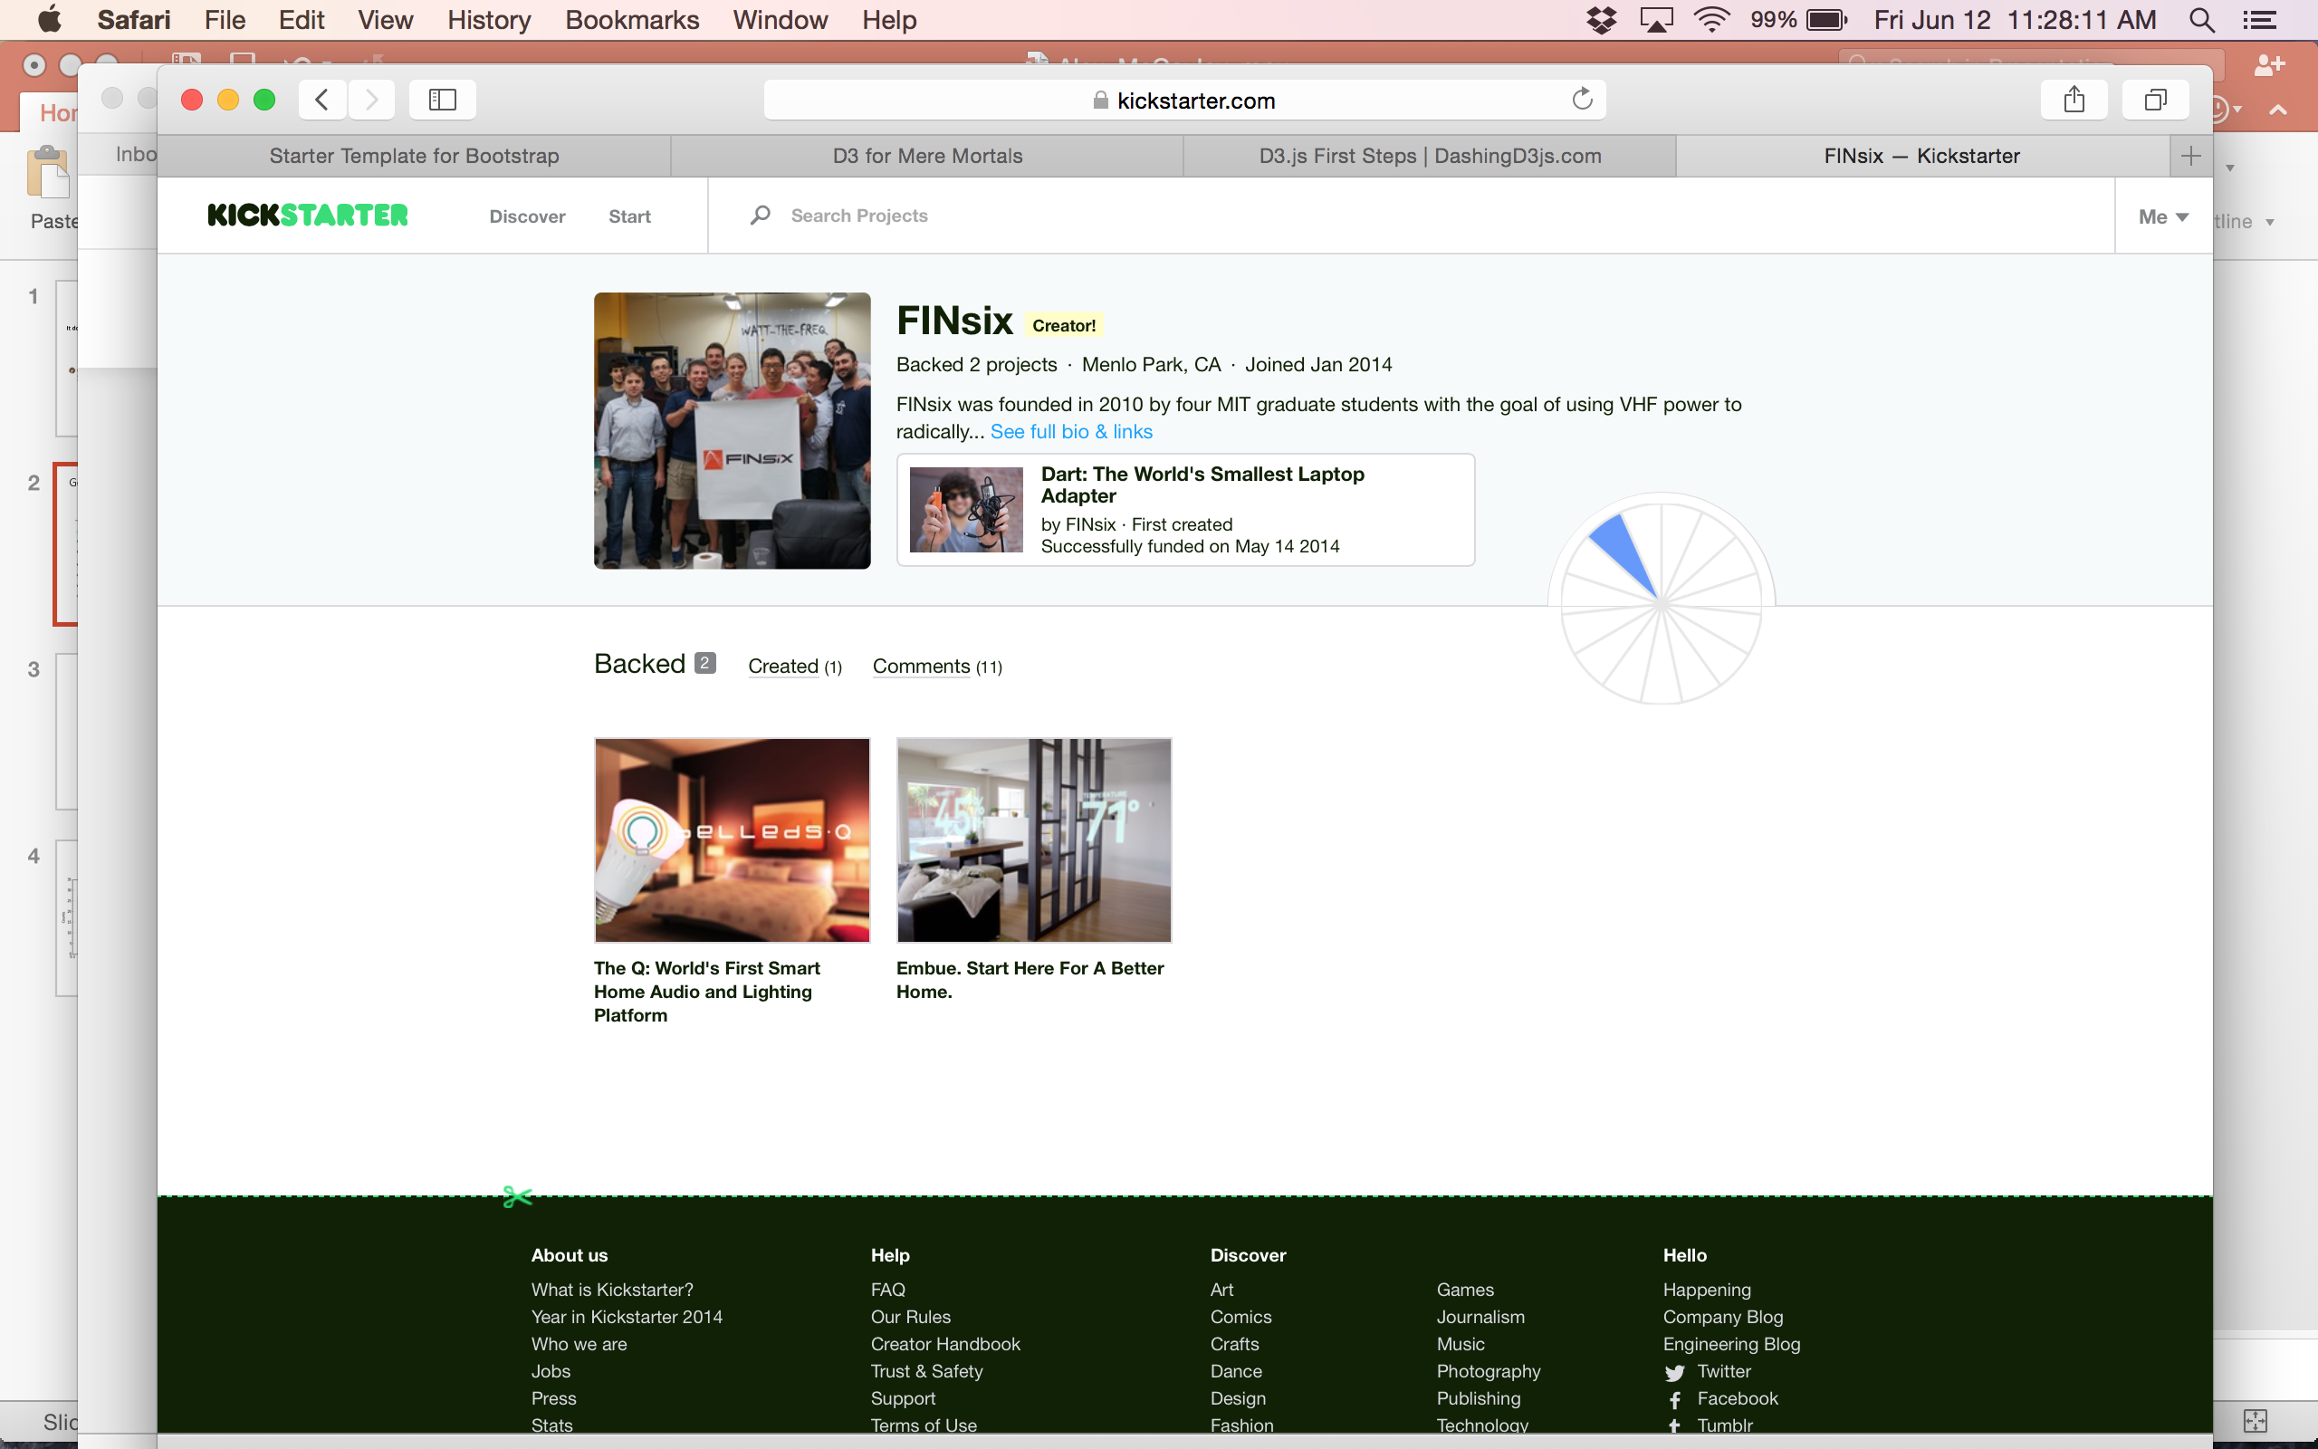
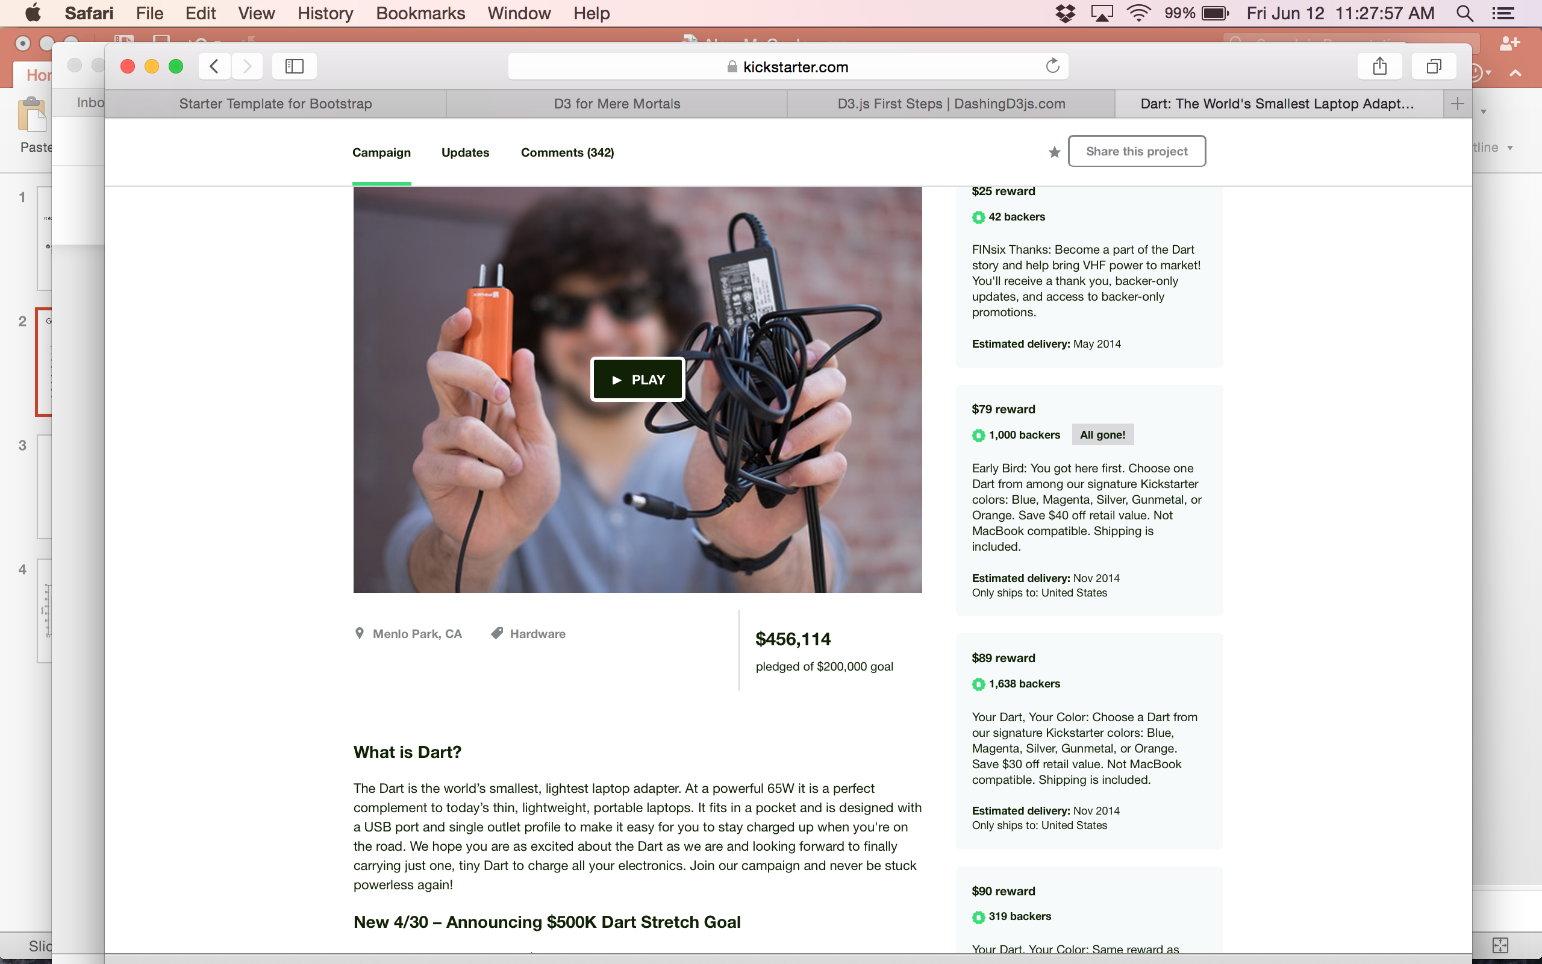
Data Sources
Project Features
Project Outcomes
Scraped from:
No data/tracking of project delivery
Creator data:
# past projects (experienced?)
# they have backed
500k tech comments
Sentiment analysis → project status
predict
Project data:
Category
# backers
$ pledged vs. goal (overfunded?)

Slide 4


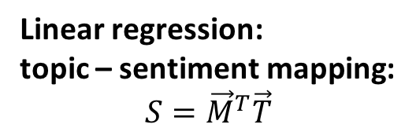
Sentiment Analysis
All comments
Workers label sentiments
Labeled sentiments
Small (1k) sample
Linear regression:
topic – sentiment mapping:
$$S={\vec{M}}^{T}\vec{T}$$
Sentiment vs. time!
Topic modeling
(Latent Dirichlet Allocation)
Comment
Comment
Comment
Topics
Curate: keep only 7 most relevant topics
Pre-process text

Slide 5
Timeline of Project Sentiments
“pledge”, “funded”
“received mine today”
“awesome”
“update”, “status”
“refund”
“delay”

Slide 6
Classification Algorithm
Build intuition: 2-D reduction
Classification results
Random Forest classifier
Good
Accuracy | 0.88
Precision | 0.6
Recall | 0.3
F1 | 0.43 (0.24 = random)
Most important feature:
$ pledged / $ goal – overfunded campaigns are more risky
Surprisingly not important:
Creator history (# previous projects)
Include initial project sentiment:
Improves predictive power
Biased (not independent of labels)
Bad

Slide 7


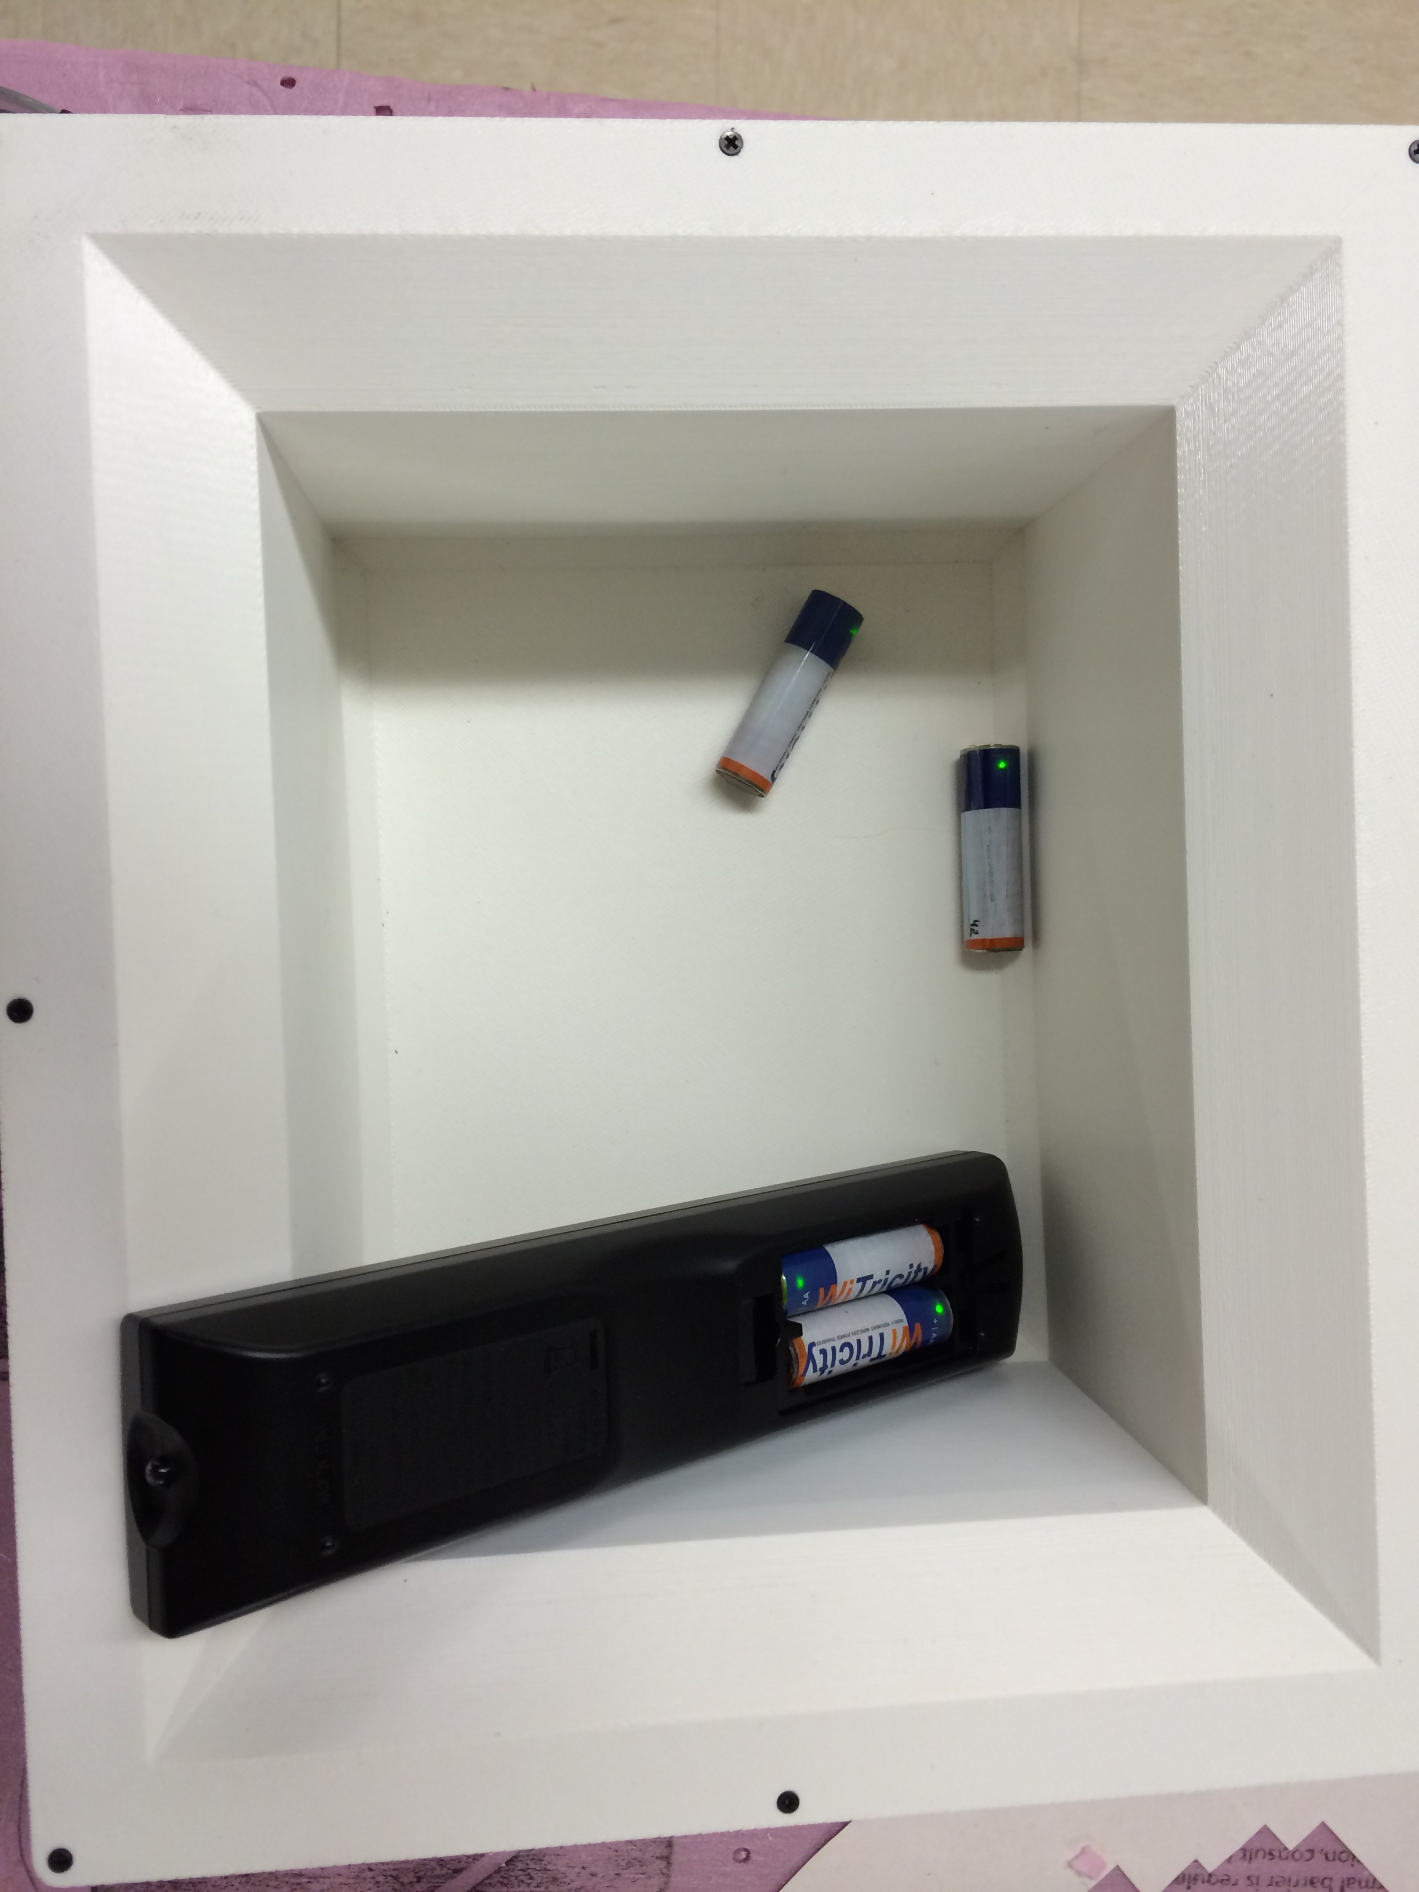
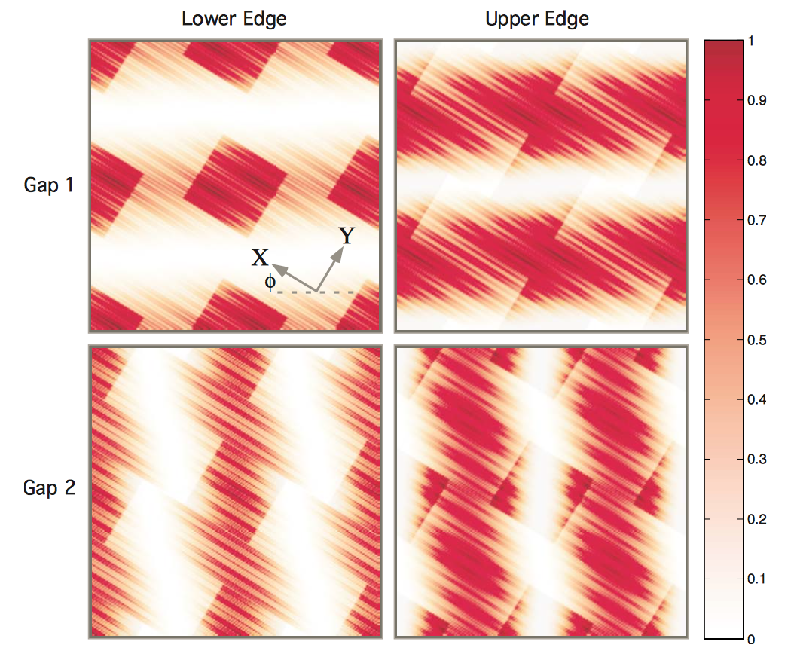


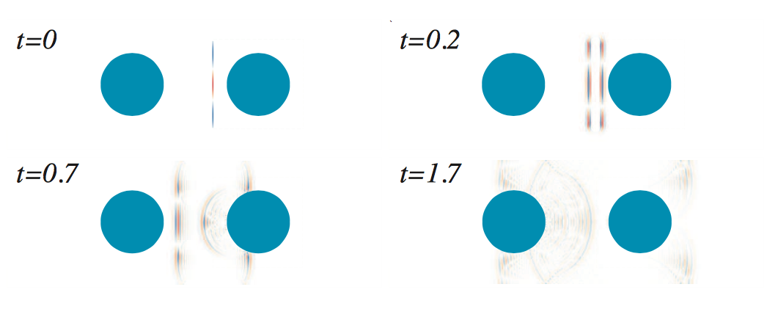
About Me
Wireless
power!
Photonic crystals, quasi-crystals, and Casimir forces
Green = charging

Slide 8
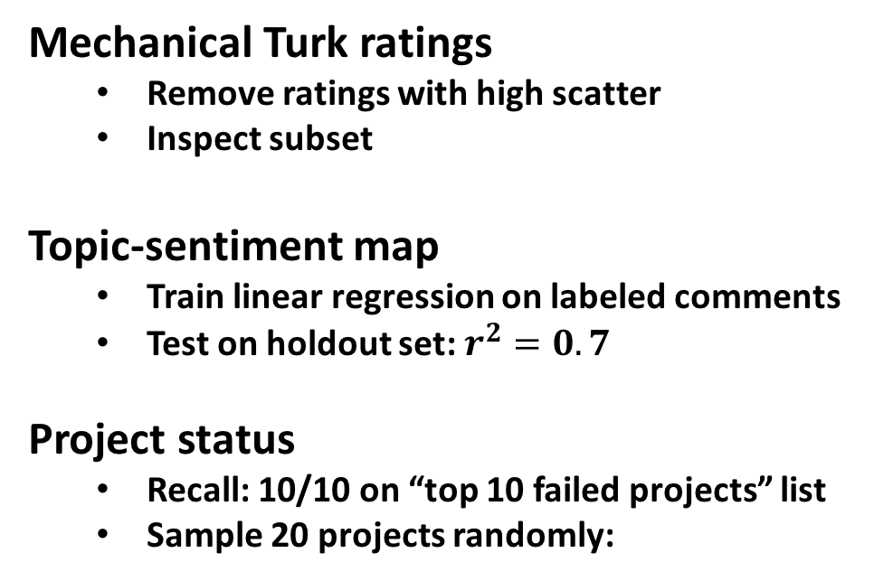
Validation
Mechanical Turk ratings
Remove ratings with high scatter
Inspect subset
Topic-sentiment map
Train linear regression on labeled comments
Test on holdout set: $r^{2}=0.7$
Project status
Recall: 10/10 on “top 10 failed projects” list
Sample 20 projects randomly:
 | N | P
N | 12 | 0
P | 3 | 5

Slide 9
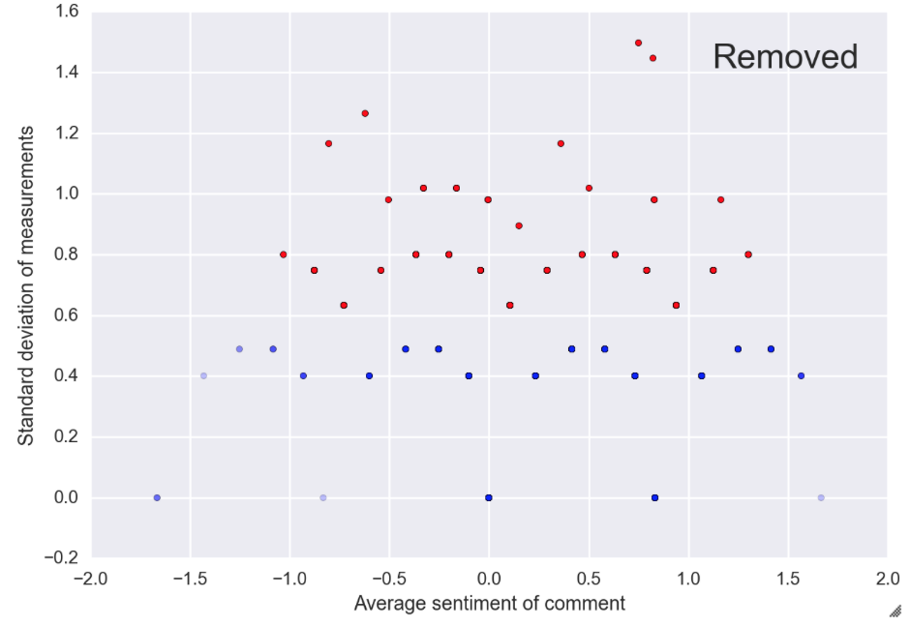
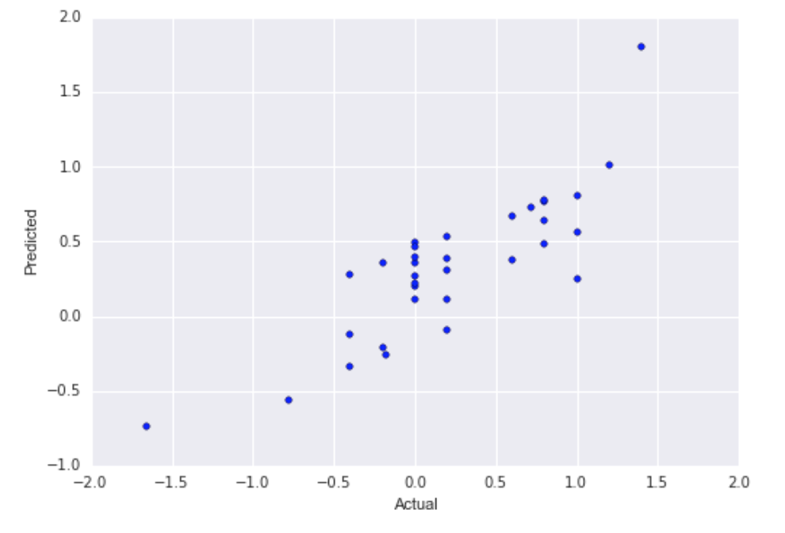
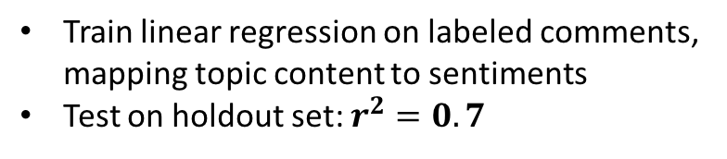
Validation: sentiment analysis
Mechanical Turk ratings
Topic-sentiment map
Remove comments with standard deviation > 0.5 (S.D. = 1.3 is a random guess)
Train linear regression on labeled comments, mapping topic content to sentiments
Test on holdout set: $r^{2}=0.7$

Slide 10
Validation: project labeling
Test on 10 well-known failure cases, gets 10/10
Test validity on random sample of 100 projects (TODO)
ROC curve
Project sentiment counts

